Slide 1
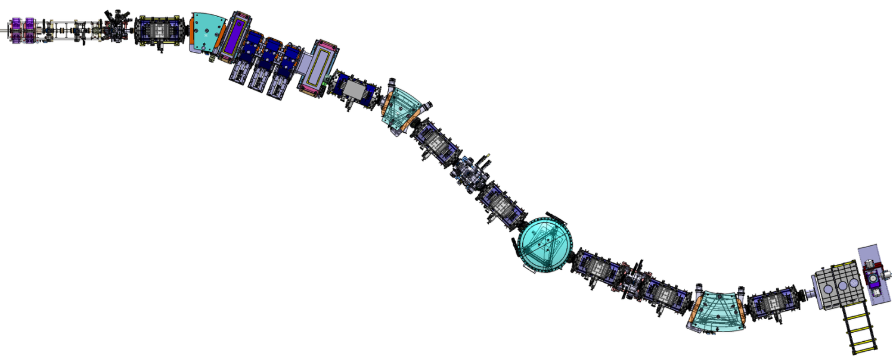
Production of ⁹⁸In with S3 Spectrometer
Slits
FH11
Slits
F1
LINAC
⁵⁸Ni (4.5MeV/u)
6 e+12 pps
D11
Mass separation
D21
Slits
F2&F2bis
Identification
Target
⁴⁵Sc (0.5mg/cm²)
ED31
Slits
F3
LEB set-up in
‘converging mode ’
Slits
F4&F4bis
Magnetic separation
D41

Slide 2
Reaction for ⁹⁸In production
⁵⁸Ni(6e+12pps) (+ Target) | ⁴⁵Sc | ⁵⁸Ni | ⁴⁶Ti | ⁴⁰Ca (+Target) | ⁶³Cu
4.5MeV/A | 2.6e-04mb 13 | - 0 | 4.5e-05mb 0.15 | 4.5MeV/A | 3.1e-04mb 24.3
7.5MeV/A | 3.8e-12mb 1.3e-07 | 8.3e-05mb 1.96 | 1.6e-10mb 7.8e-04 | 7.5MeV/A | 1.3e-11mb 7.99e-07
10MeV/A | 4.8e-19mb 0 | 3.8e-04mb 10.06 | - 0 | 10MeV/A | 3.7e-18mb 0
14.5MeV/A | - 0 | 9.6e.05mb 12.42 | 2.3e-25mb 0 | 14.5MeV/A | 2.2e-29mb 0

Slide 3
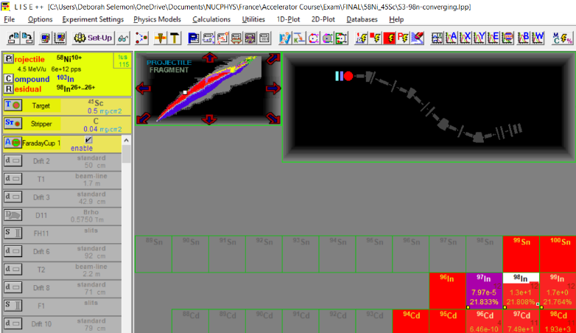
Reaction for ⁹⁸In production

Slide 4

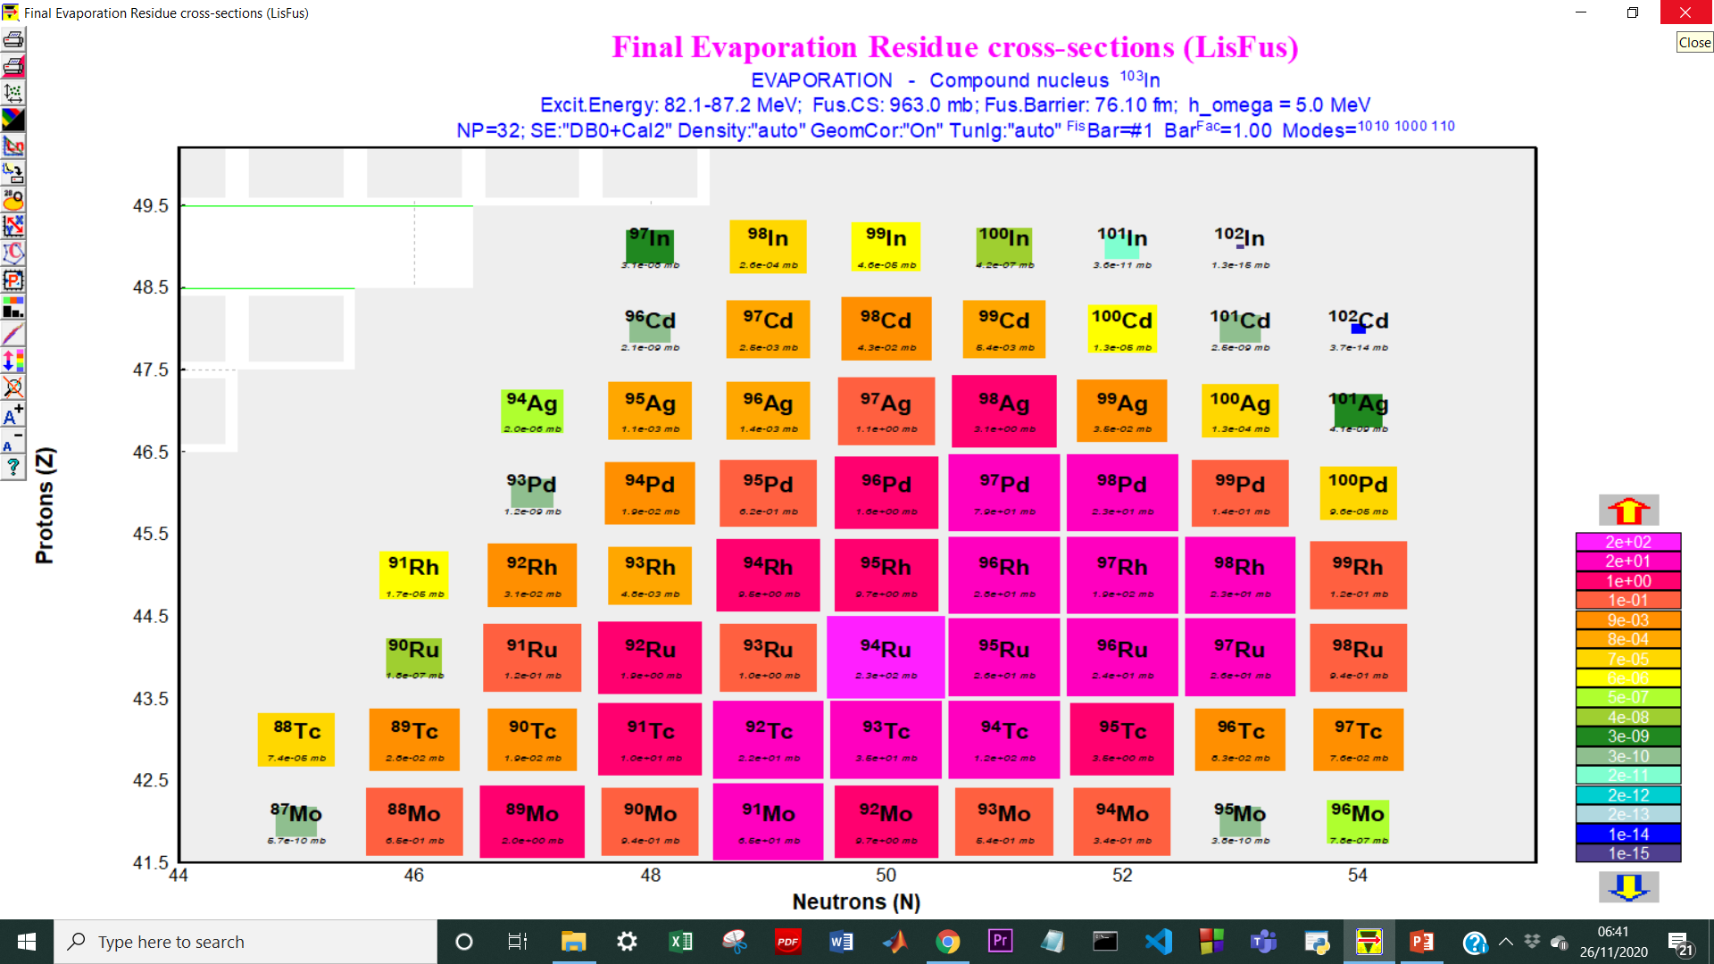
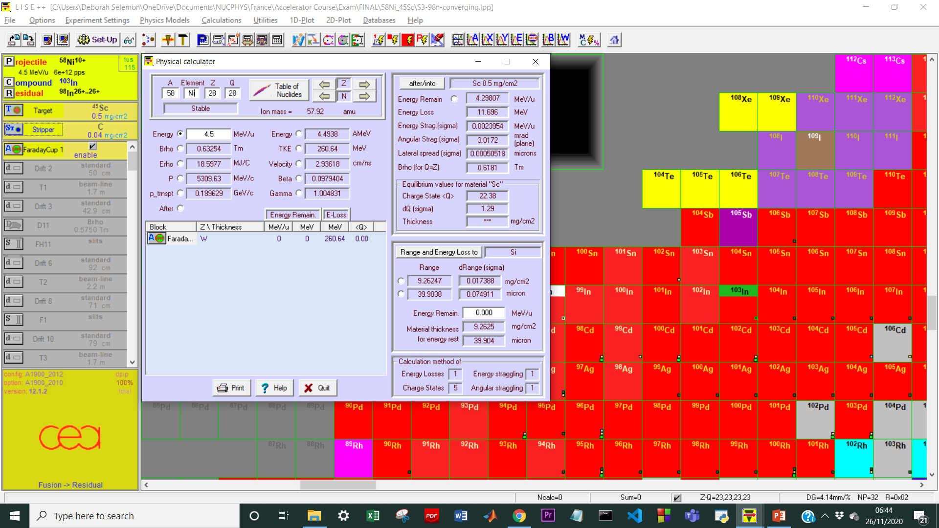
Reaction for ⁹⁸In production
⁹⁸In = 2.6e-04mb

Slide 5
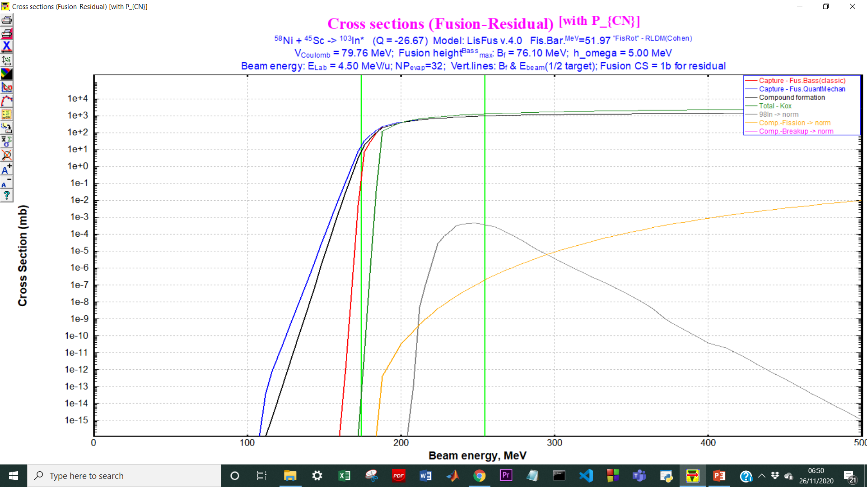
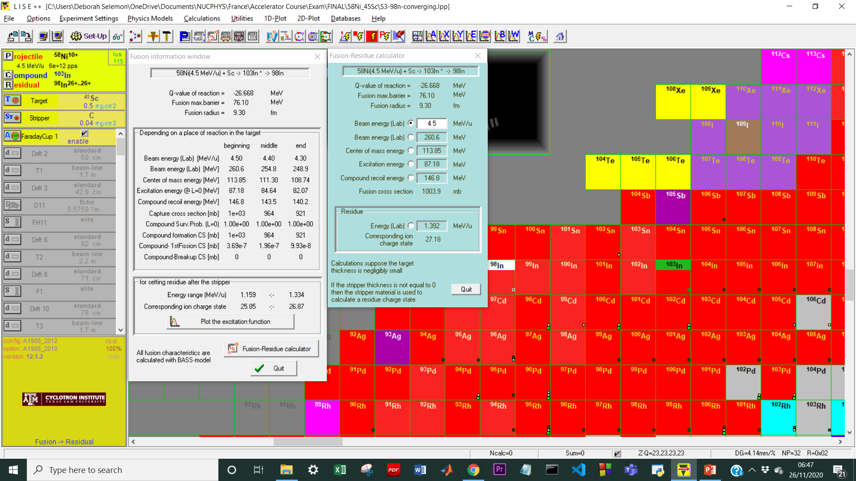
Fusion Cross Section Information
≈ 1.8e-04mb @ <E_{b}>
σ_{f}(CN)
Evaluated total fusion cross section (CN) = 1003.9mb
“Most favourable” charge state of the fragment after the target+stripper ≈ 27

Slide 6
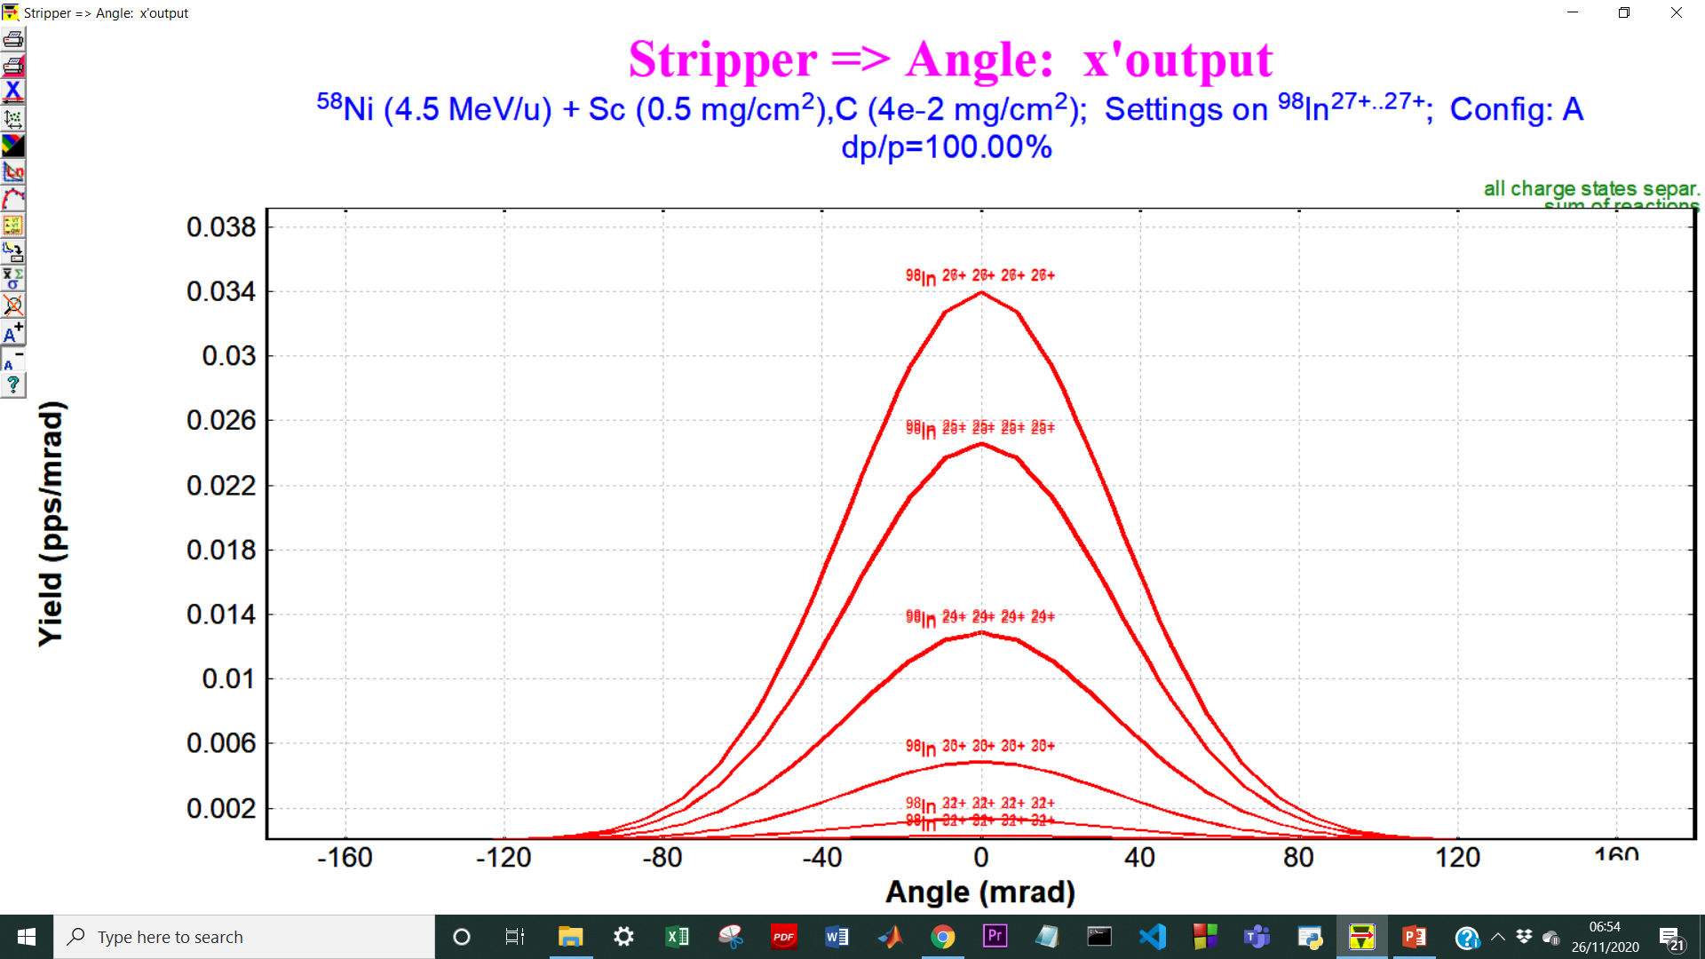
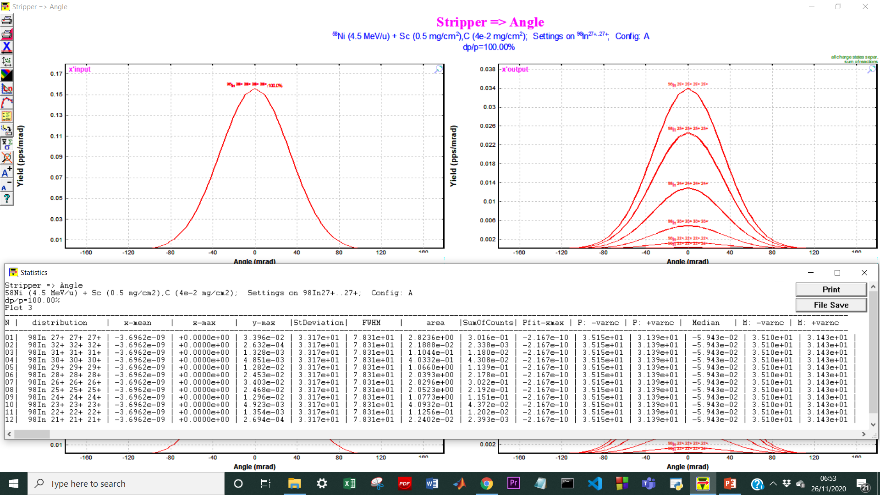
Angular Distribution of ⁹⁸In
Sigma ≈ 33mrad
~ 75% transmission
at spectrometer entrance
=> 20msr angular acceptance

Slide 7
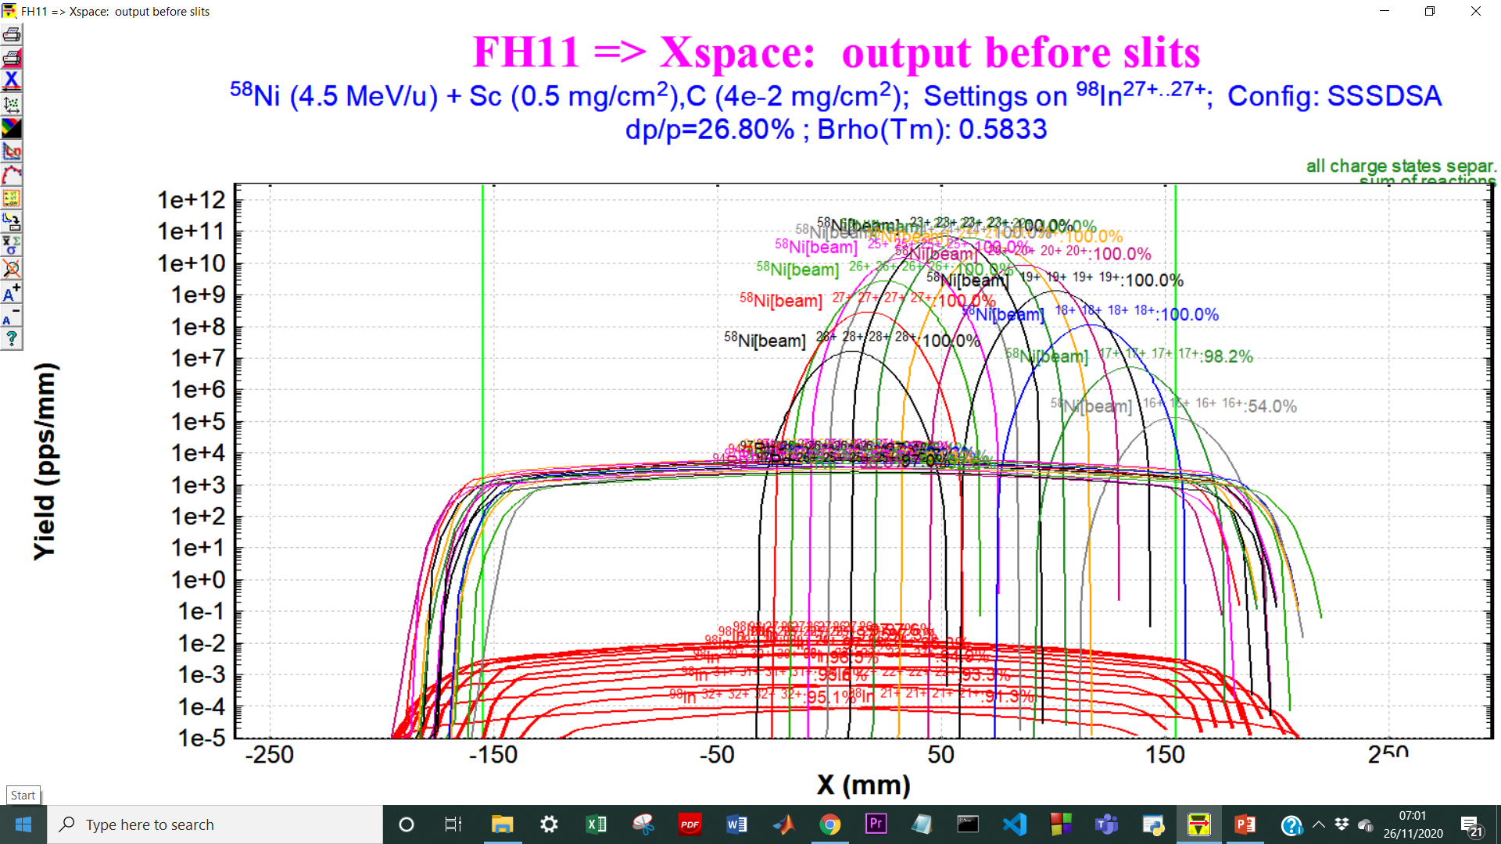
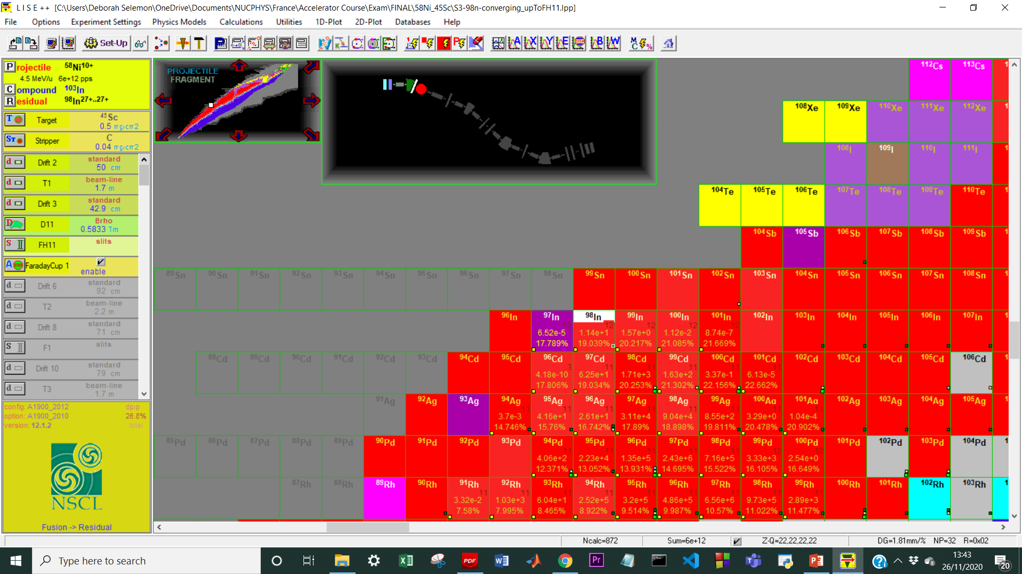

Separation of fragments through slits
Slit opening
= ± 150mm
Total number of ions produced = 6e+12
⁹⁸In produced = 1.1e+1pps

Slide 8
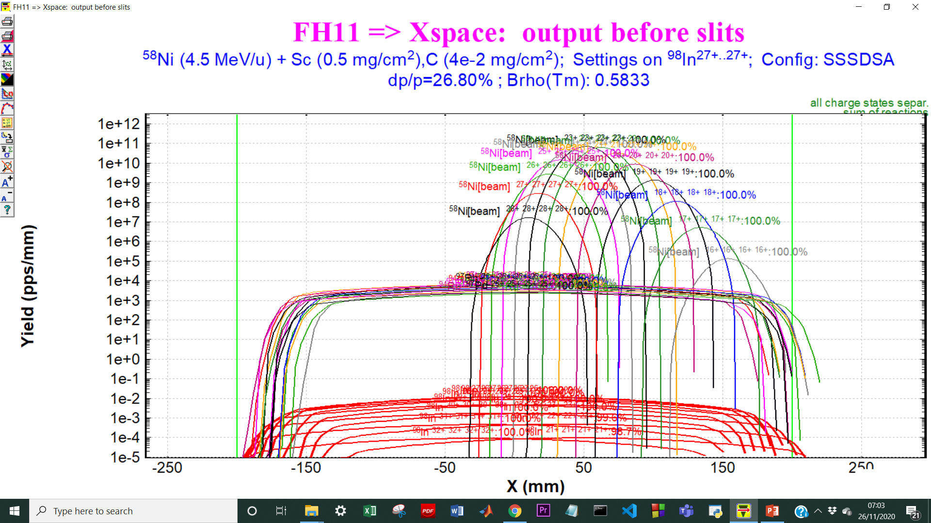
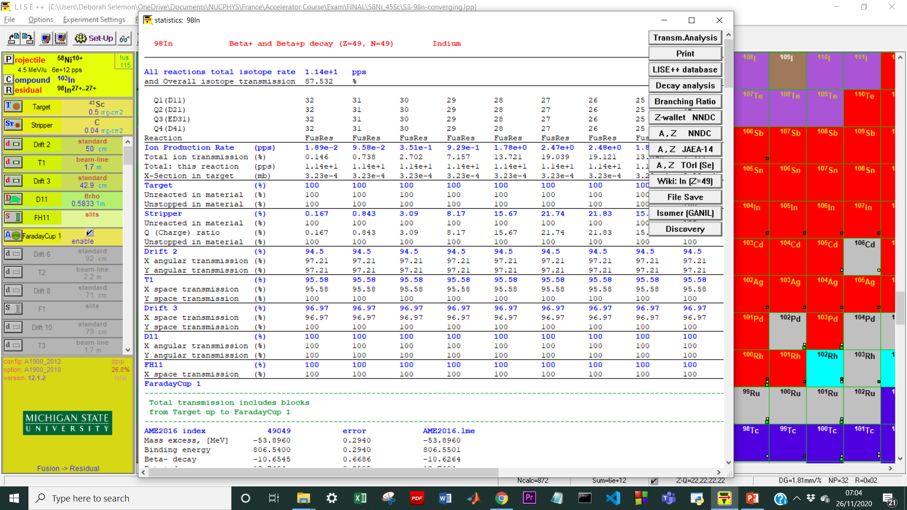
Separation of fragments through slits
Slit opening
= ± 200mm
Primary beam intensity
≈ e+11pps
Total number of ions produced = 6e+12
⁹⁸In produced = 1.1e+1pps

Slide 9
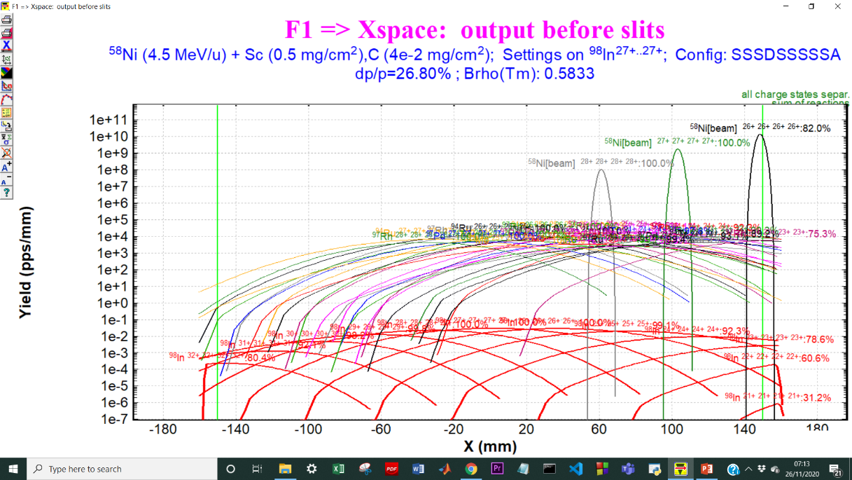
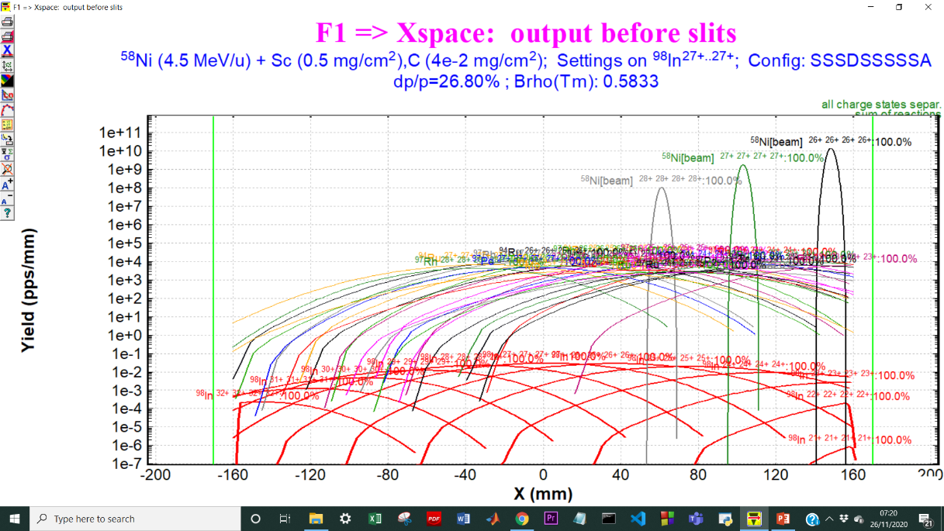
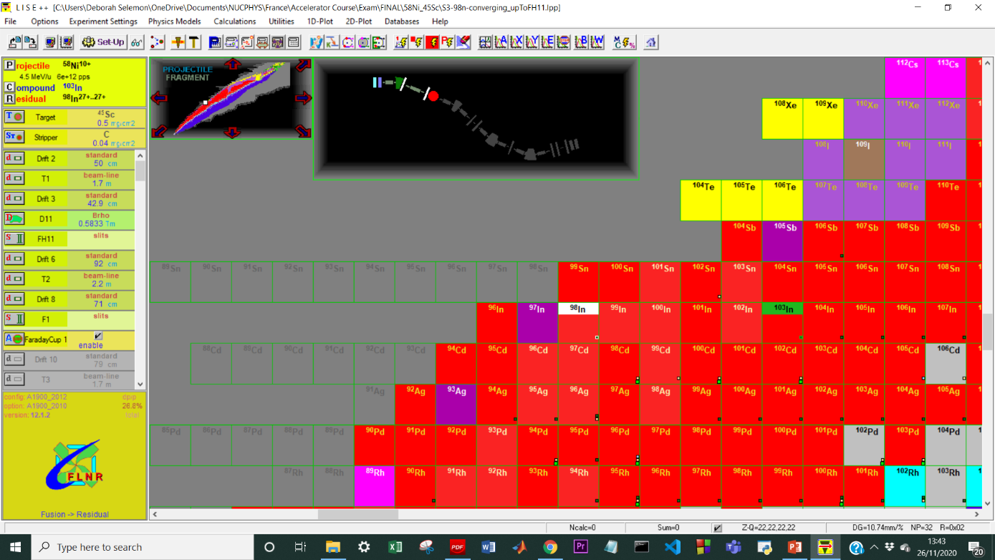

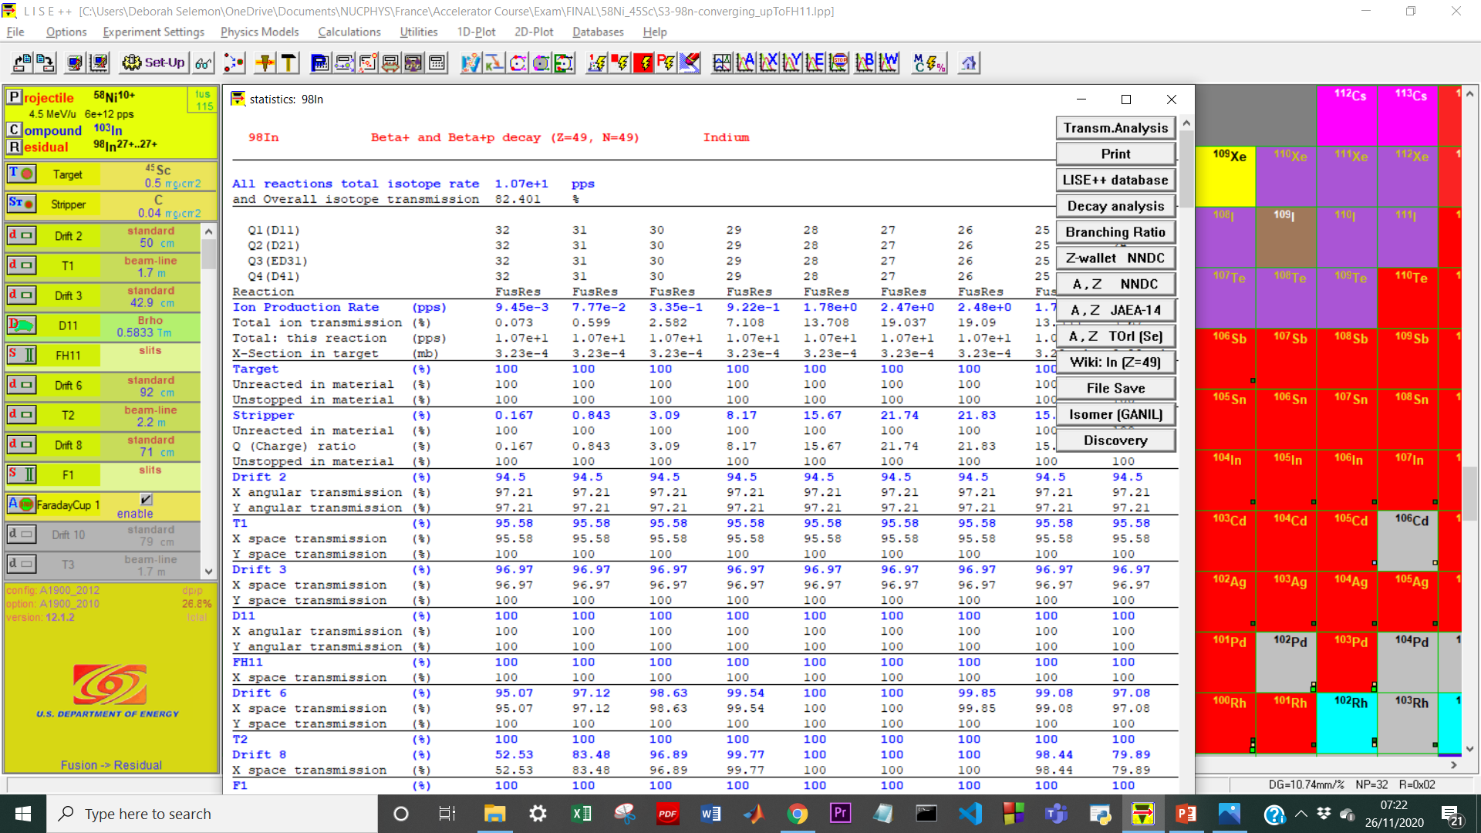
Separation of fragments through slits
Slit opening (default)
= ± 150mm
Slit opening
= ± 170mm
Primary beam intensity
≈ e+10pps
Total number of ions produced = 6e+12
⁹⁸In produced = 1.07e+1pps

Slide 10
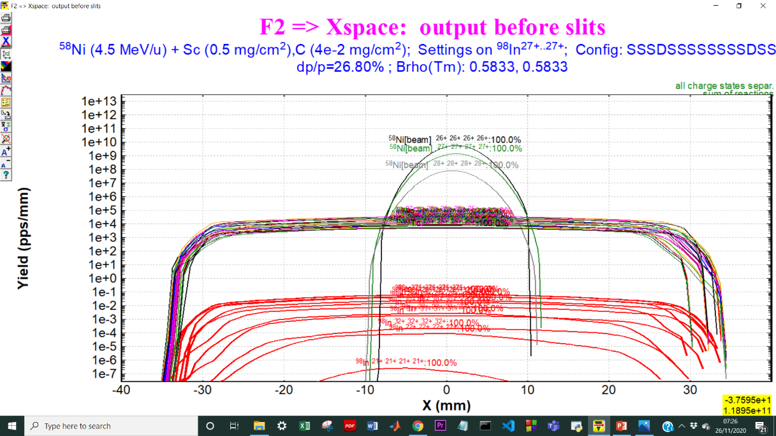
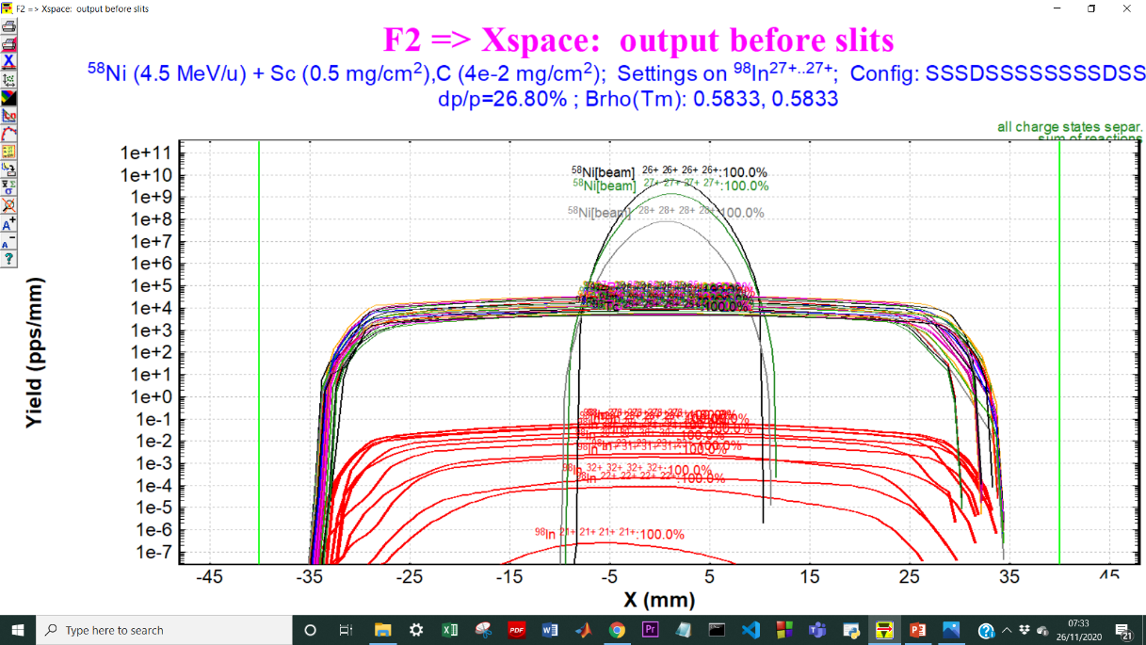

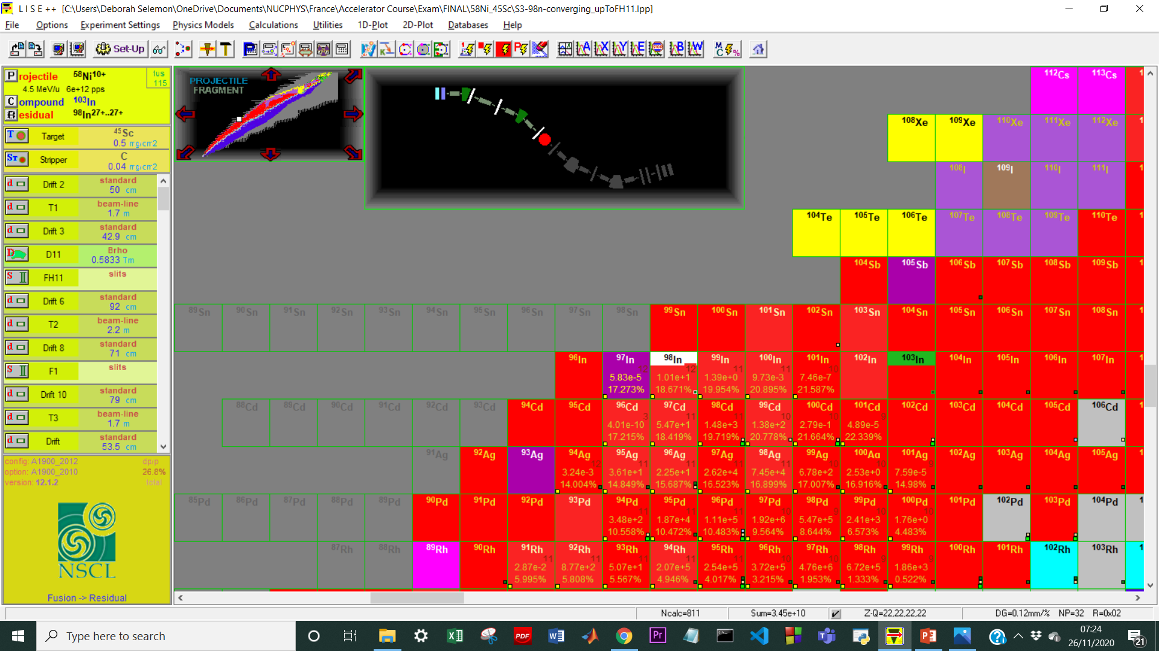
Separation of fragments through slits
Slit opening (default)
= ± 150mm
Slit opening
= ± 40mm
Primary beam intensity
≈ e+10pps
Total number of ions produced = 3.45e+10
⁹⁸In produced = 1.01e+1pps

Slide 11
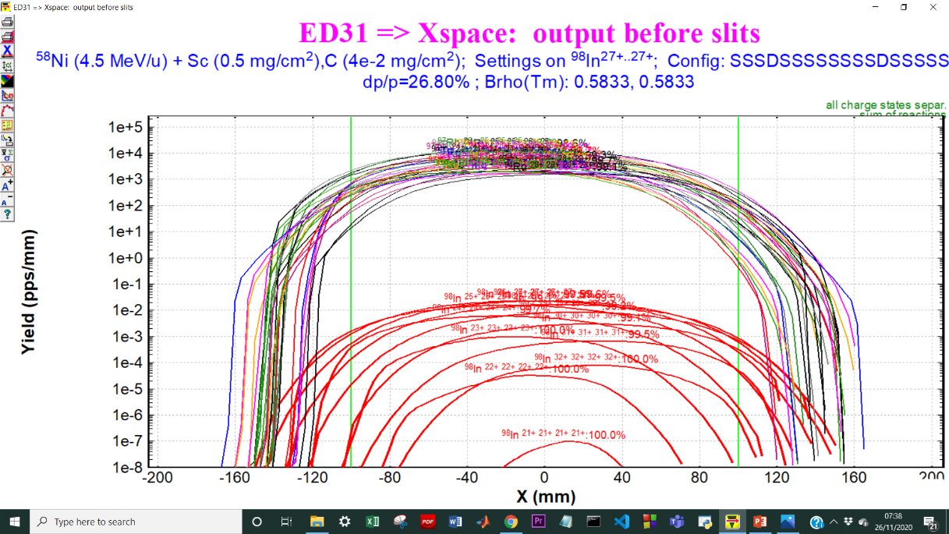
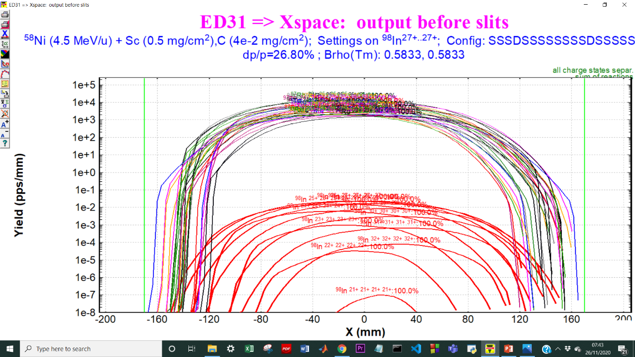

Separation of fragments
Slit opening
= ± 100mm
Slit opening
= ± 170mm
Total number of ions produced = 2.2e+07
⁹⁸In produced = 1e+1pps
No Primary beam !
Residue beam intensity
≈ 1e+4pps

Slide 12
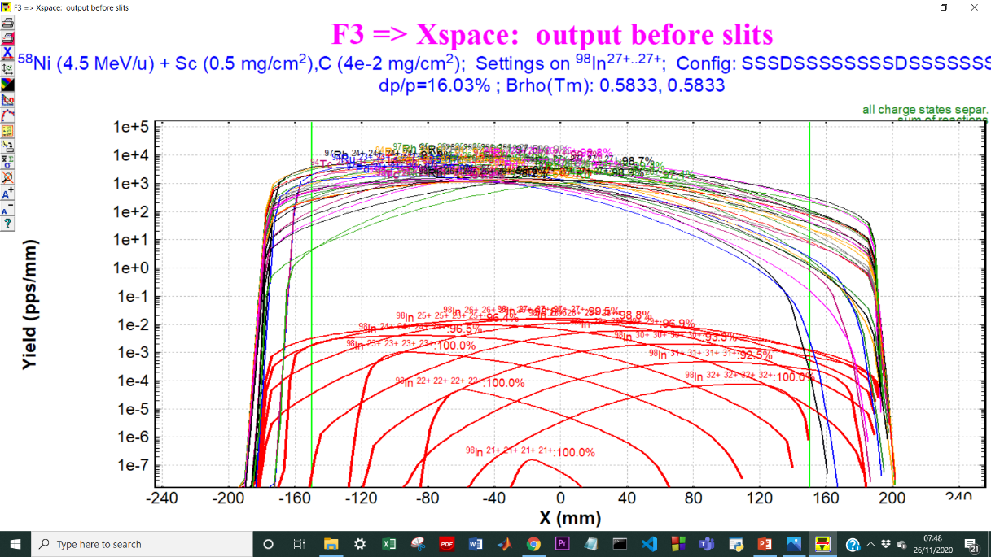
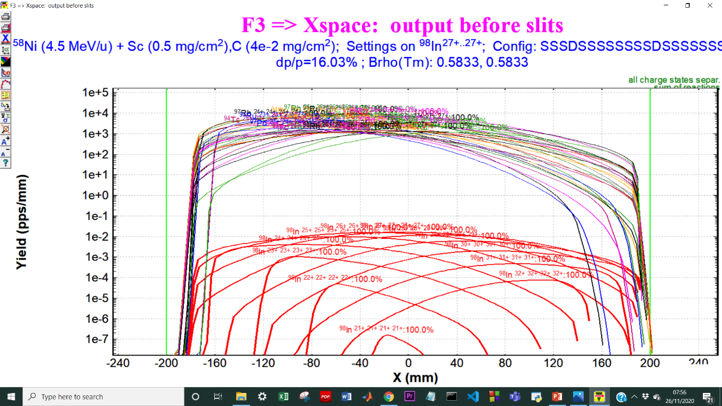

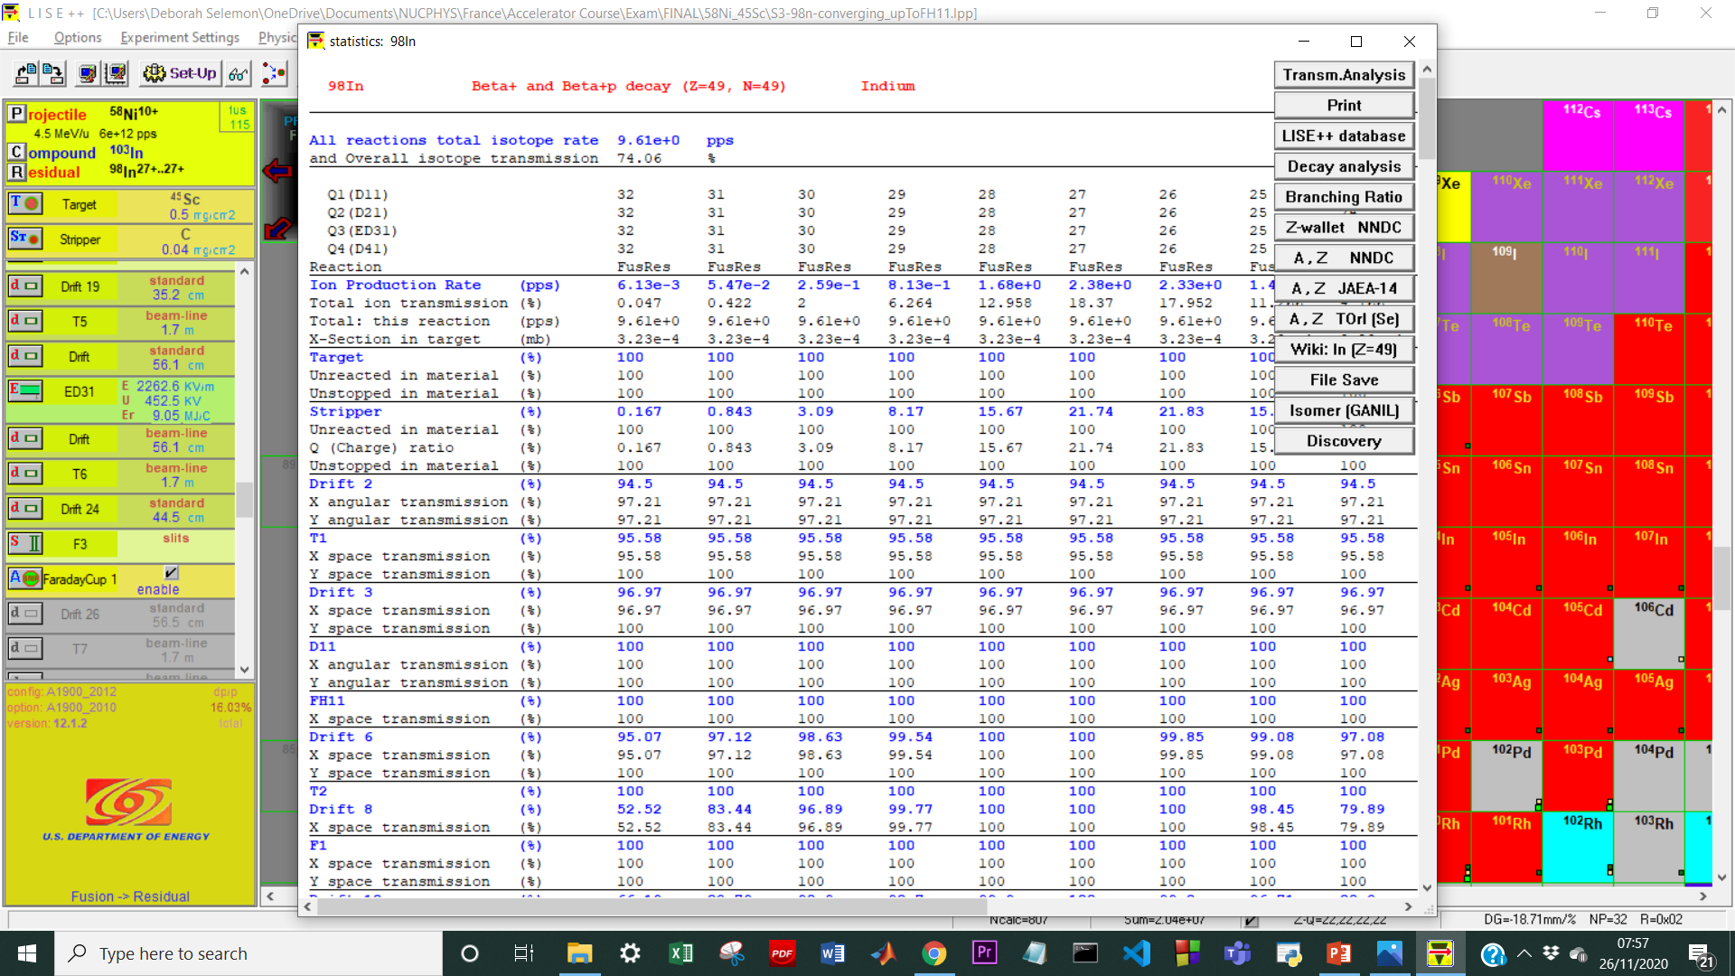
Separation of fragments through slits
Slit opening (default)
= ± 150mm
Slit opening
= ± 200mm
Total number of ions produced = 1.9e+07
⁹⁸In produced = 9.43e+0pps
Residue beam intensity
≈ 1.5e+3pps

Slide 13
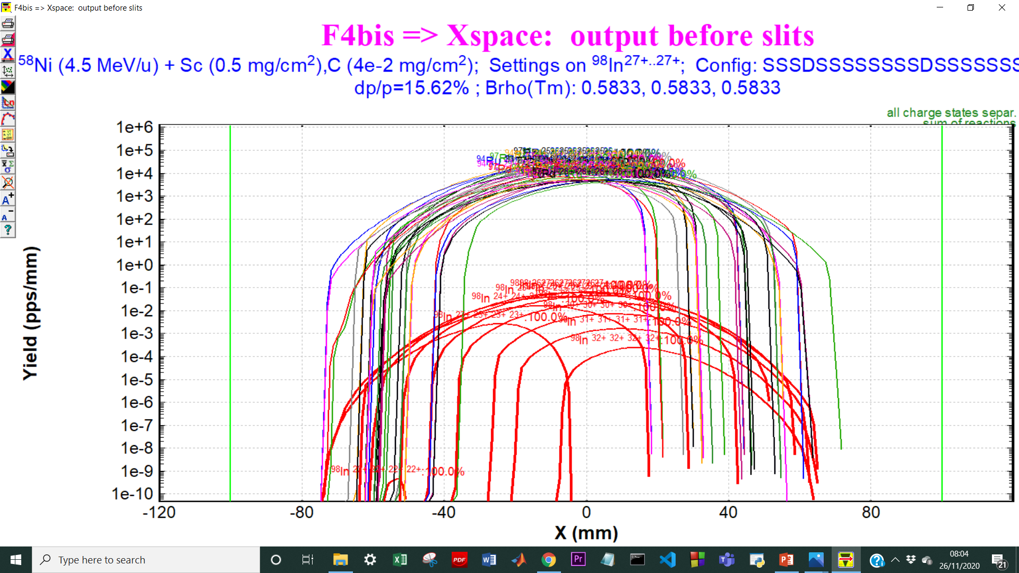

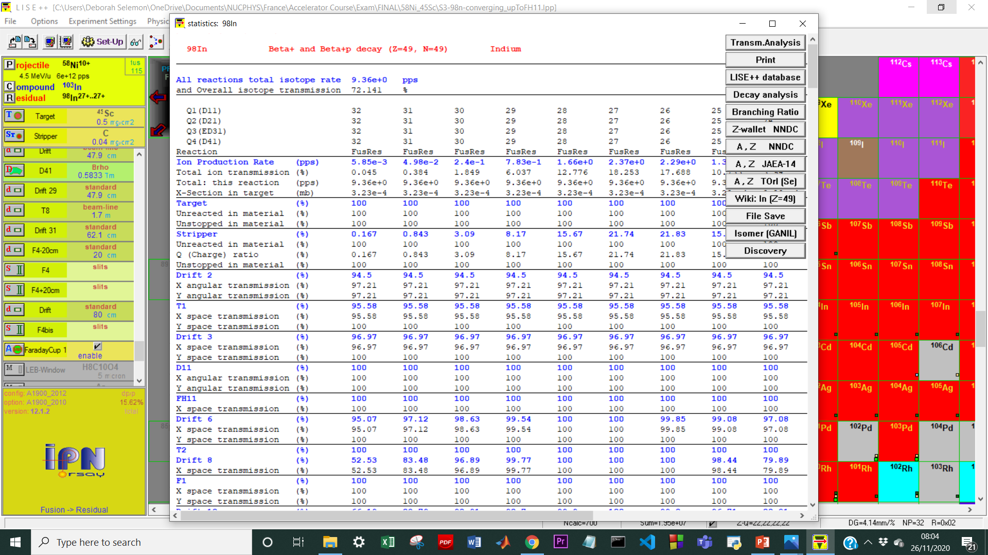
Separation of fragments through slits
Total number of ions produced = 1.95e+07
⁹⁸In produced = 9.36e+0pps

Slide 14
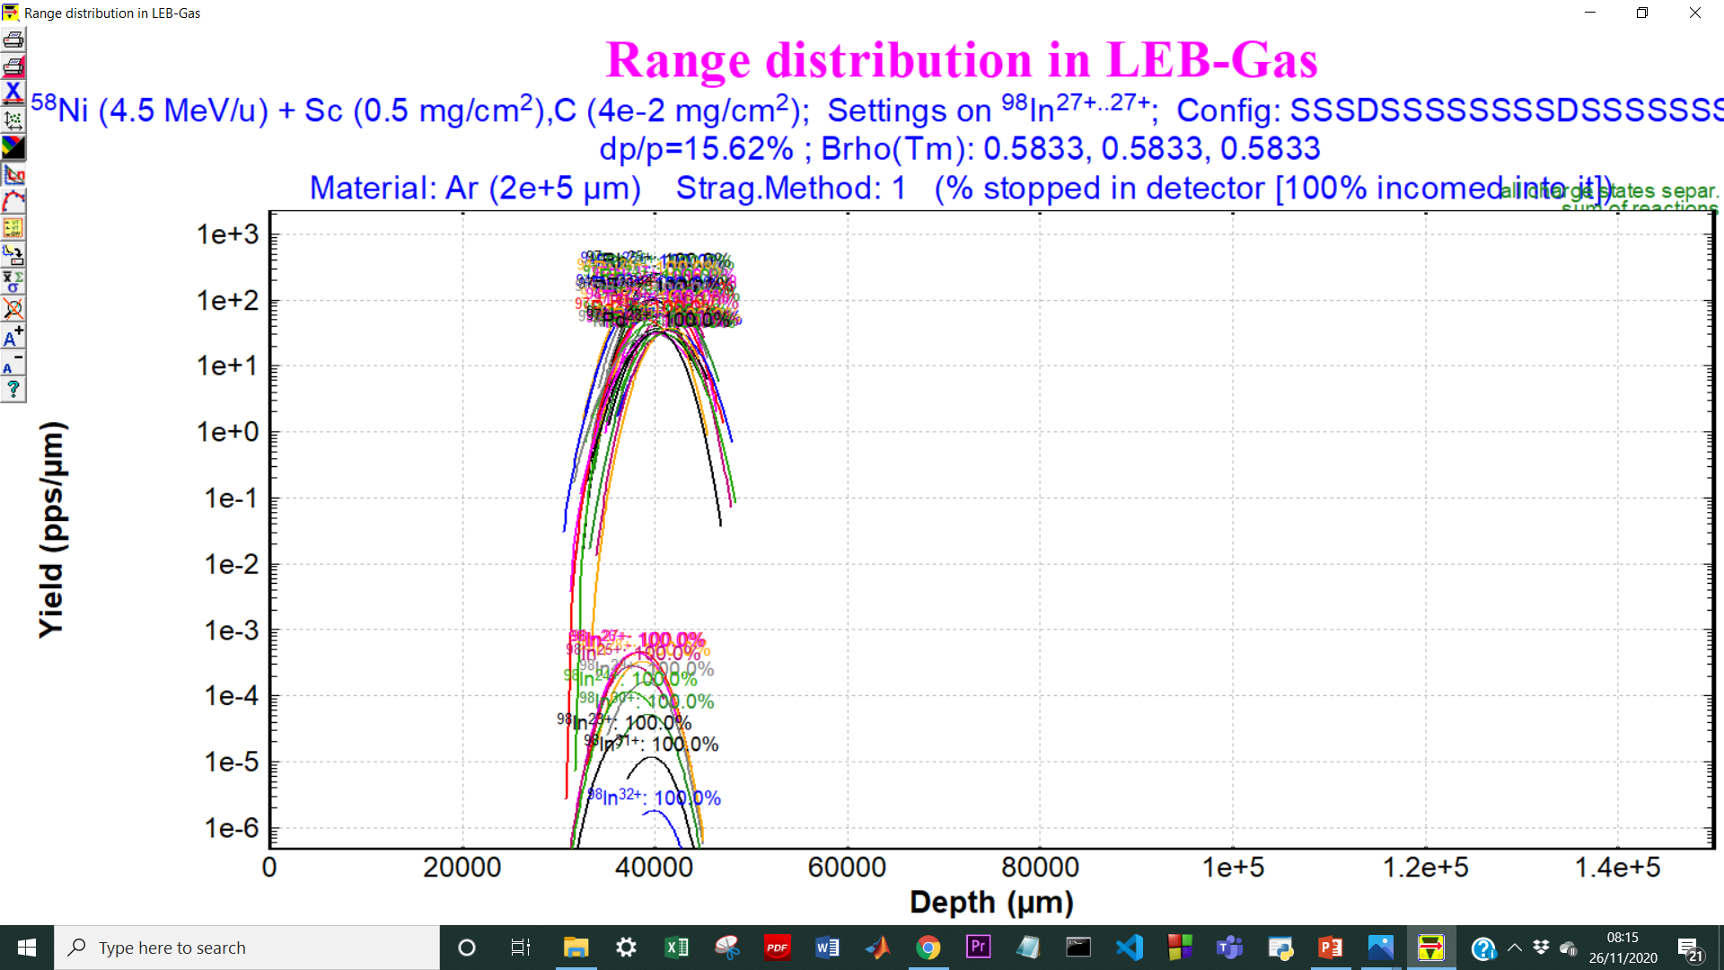
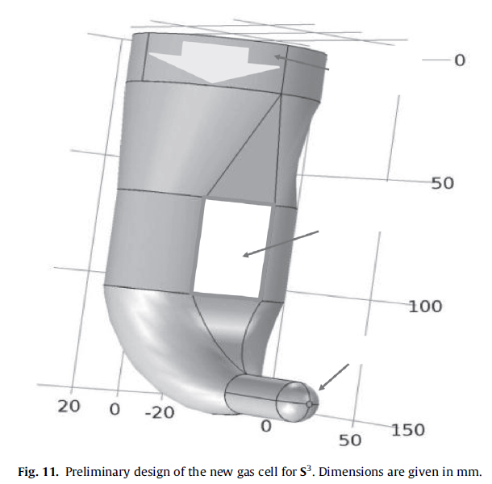
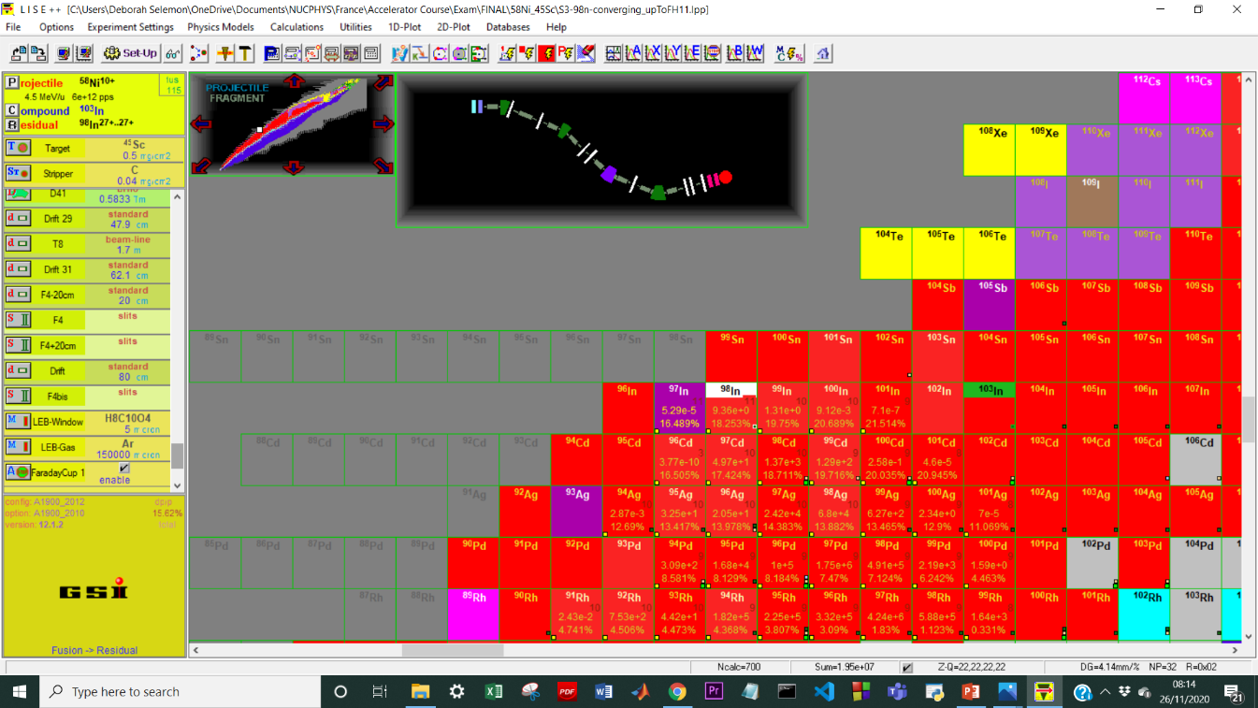

Implantation in LEB gas
Implantation depth achieved
= (30-45)e+03μm
R. Ferrer et al., NIM B317, 570 (2013)
Total number of ions produced = 1.95e+07
⁹⁸In produced = 9.36e+0pps

